Slide 1
Team B
Team Members: Giulio, Abi, Jerry, Tom, Syazwan, Muhammad

Slide 2
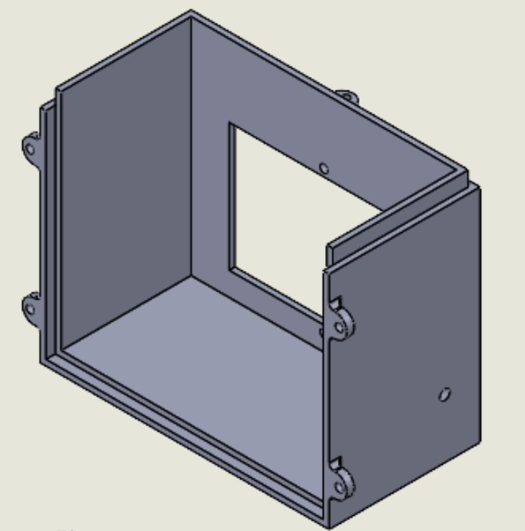
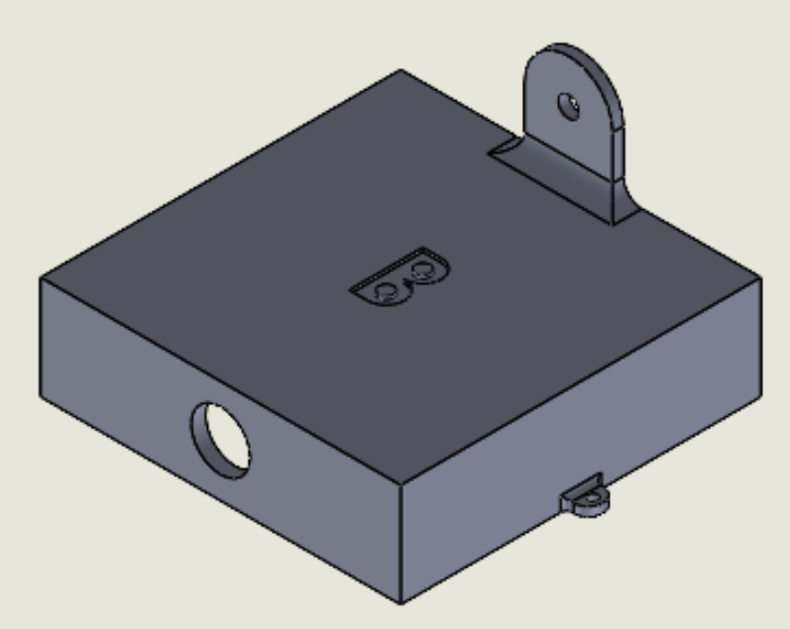
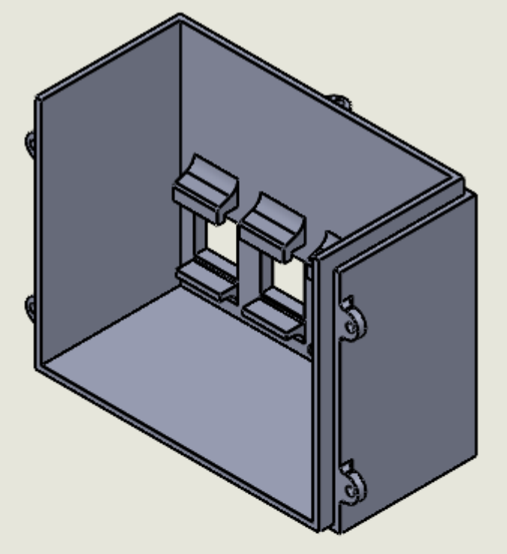
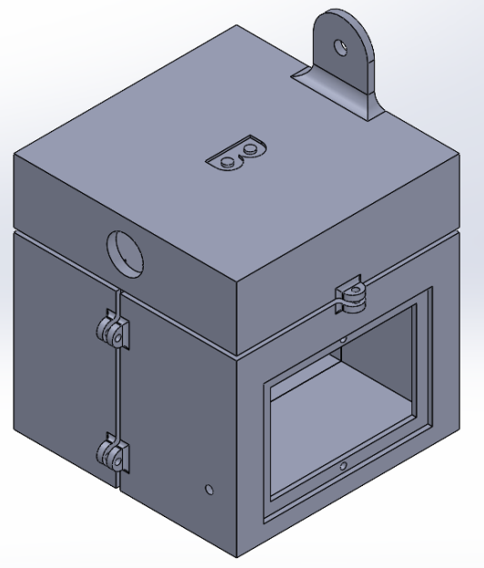
Box Design (Giulio)
3 parts
Opened from top
External mounting
Water-resistant joint
4mm width
RJ45 clipping feature
Attempted test prints

Slide 3
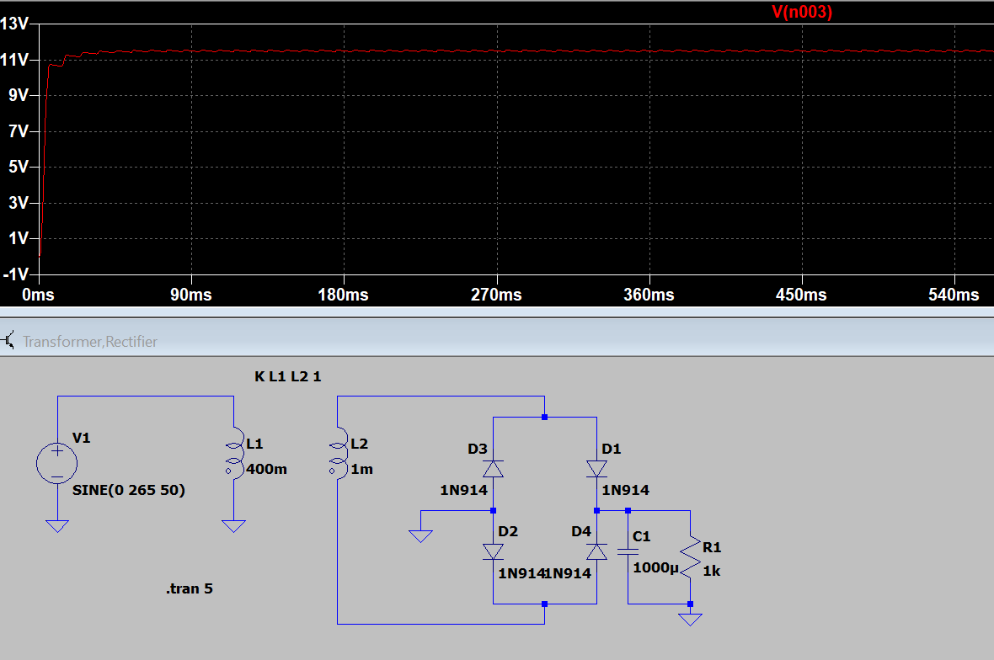
PSU Design (Abi)
Started with transformer PSU design – 17% efficiency
Researched other PSU designs (Switch Mode and Capacitor Coupled)
Started with switch mode
Changed design to Capacitor Coupled after more consideration

Slide 4
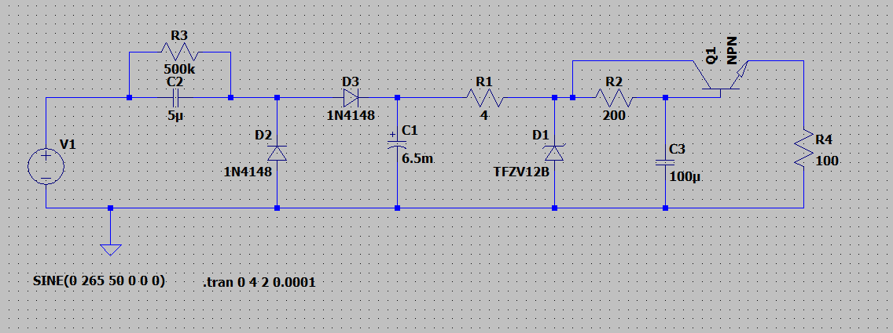
PSU design – Capacitor PSU
(Ziteng Wang)

Slide 5
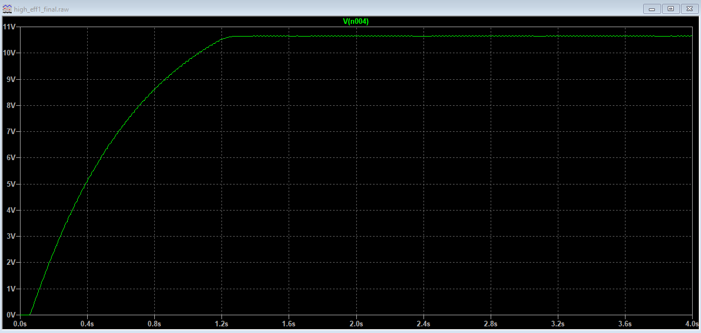
Output Waveform
Output Voltage : 10.65V
Output Current:
106mA
Output Power:
1.134W
Input Power:
1.714W
Efficiency: 66%

Slide 6
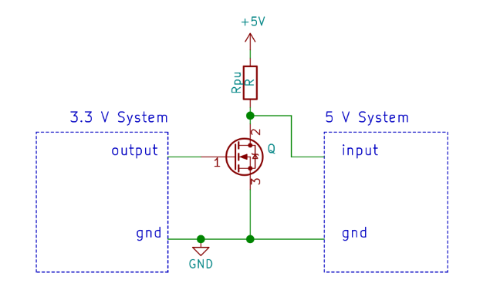
Interface Circuitry Progress/Plans(Tom)
Key priority moving forwards.
PWM for 0-10V analogue input.
Voltage scaling for analogue outputs.
Potential use of mosfets for TTL Logic I/O.
Source:https://next-hack.com/index.php/2020/02/15/how-to-interface-a-3-3v-output-to-a-5v-input/
(also from lecture notes).

Slide 7
Software Progress (Syazwan)
Made sure that the display is working as intended.
  Printed strings, integers and floats on the display.
  Managed to make simple drawing on the display(battery shape and graphs)
Defined all the pins (inputs and outputs) and made the display to work on port B and D.
Initialized ADC code :
  To be used in reading analogue inputs.
  Implemented a function that can calculate Vrms and Irms.
Set up timer and interrupt service routine to be used in calculating rms and to add an internal counter.
Still working on PWM and control flow.
Need to improve the display design. (Maybe even making a GUI )

Slide 8
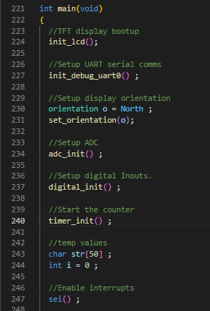
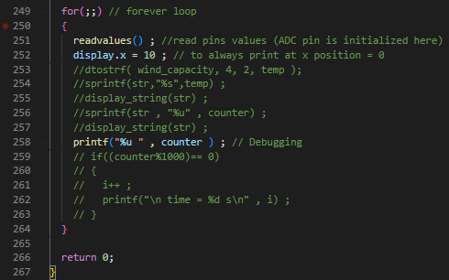
Snippets of code from prog.c

Slide 9
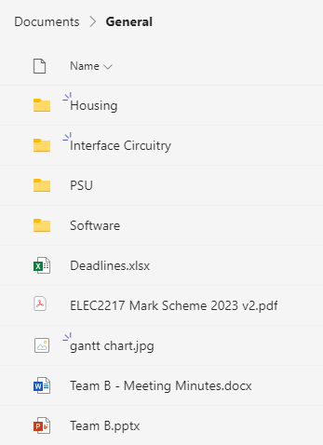
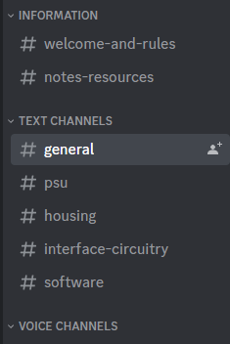
Integration, QA and Simulation (Muhammad)
Making sure all aspect of the smart meter are according to the guidelines and specifications given:
  Communicated with other area leads about improvements and concerns with current design
  Synchronised all platforms of communication and file-sharing (Teams, WhatsApp, Discord) for ease of access to make sure everyone is on the same page.
Wrote a guide for related how-to for quick install such as running Il Matto software on personal PC How to Run D5 Smartmeter using avrdude (notion.site)
Planning to synchronise the codebase using VCS such as Git.

Slide 10
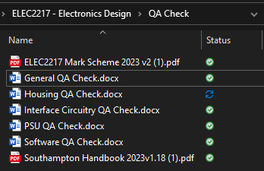
QA
Compiled and categorized relevant area specifications and targets from given documents such as guidebook and mark scheme.
Plans to add additional features for better UI/UX such as app/bluetooth control if progress went smoothly!

Slide 11
Simulation
Installed LABView software and messed around with it a bit to familiarize myself with the UI etc.
Plans to try loading the test profiles as soon as we finish prototyping the algorithm for simulation
Best approach is to design a flowchart that's general to all three scenario so we can optimise it easier when final scenario is published

